Slide 1
The Impact of Viking Settlements on the Cultural and Economic Development of County Dublin
An exploration of Viking influence in Ireland
Focus on cultural and economic ramifications in Dublin

Slide 2
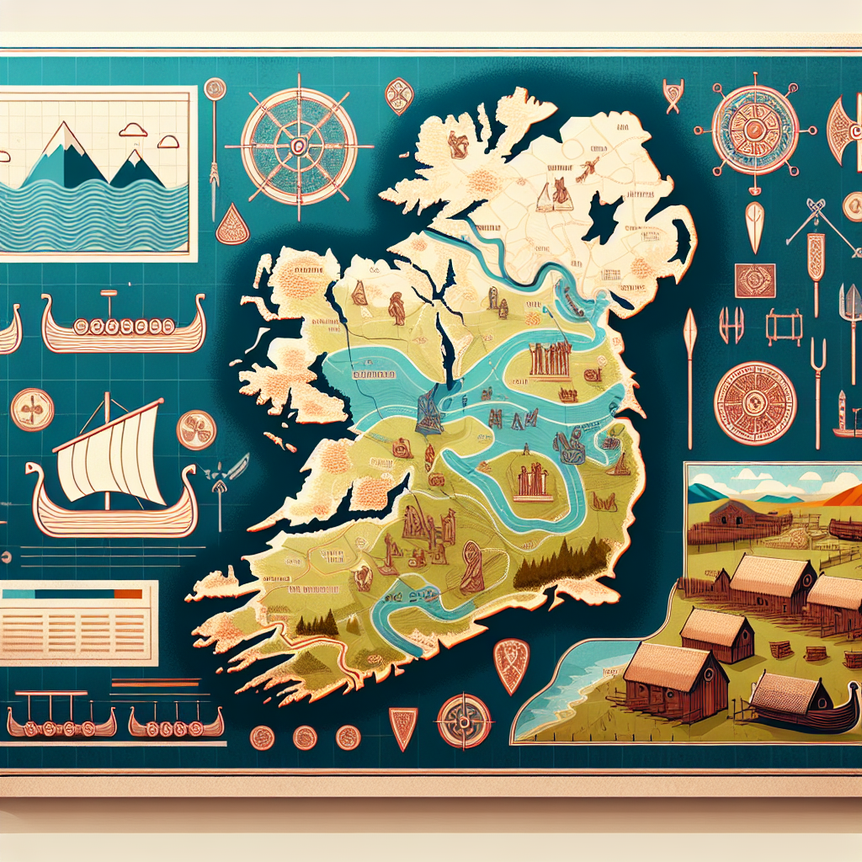
Historical Context of Viking Settlements
Overview of Viking Age (circa 793-1066 AD)
Introduction of the Norse as traders and settlers in Ireland

Slide 3
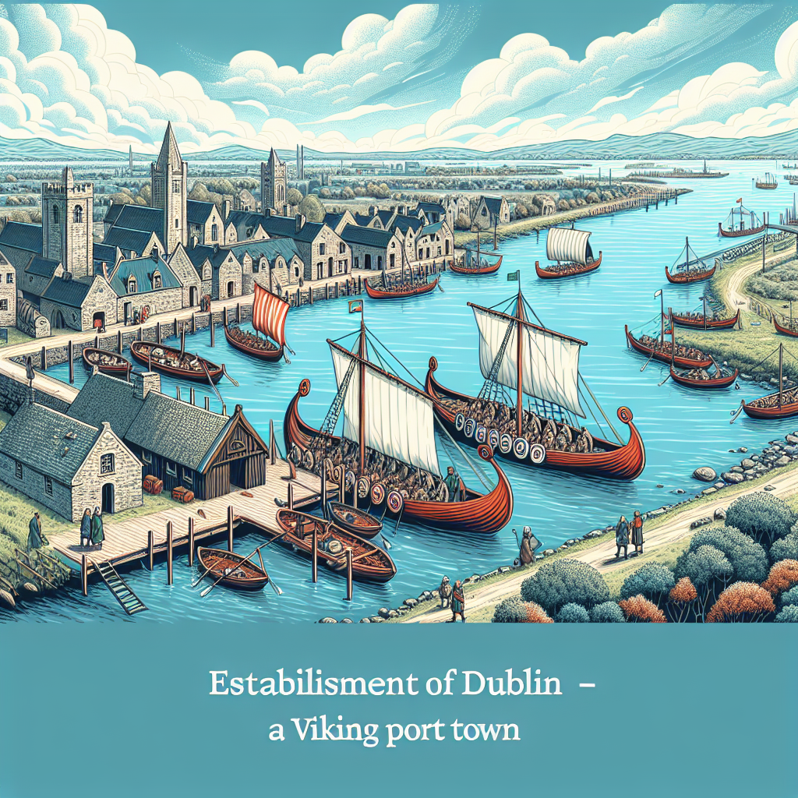
Establishment of Dublin – A Viking Port Town
Founding of Dubhlinn as a major trading hub around 841 AD
Geographical advantages: access to the sea and rivers

Slide 4

Cultural Exchange and Integration
Influence of Viking language, art, and religion on Dublin's culture
Intermarriage and cultural assimilation with local Gaelic populations

Slide 5

Economic Transformation through Trade
Viking trade networks connecting Dublin with Europe and beyond
Introduction of new commodities and crafting techniques

Slide 6
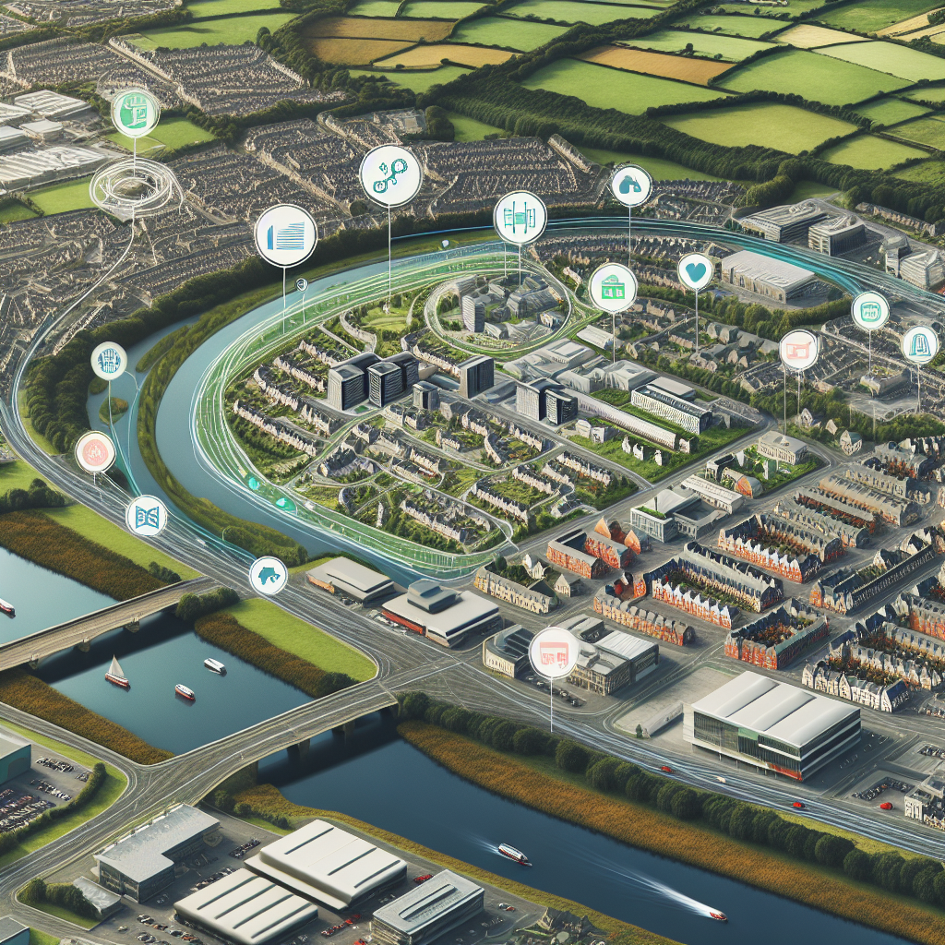
Urban Planning and Infrastructure Development
Viking contributions to urban layout, including street design and fortifications
Evidence of advanced artisan workshops and trading facilities

Slide 7
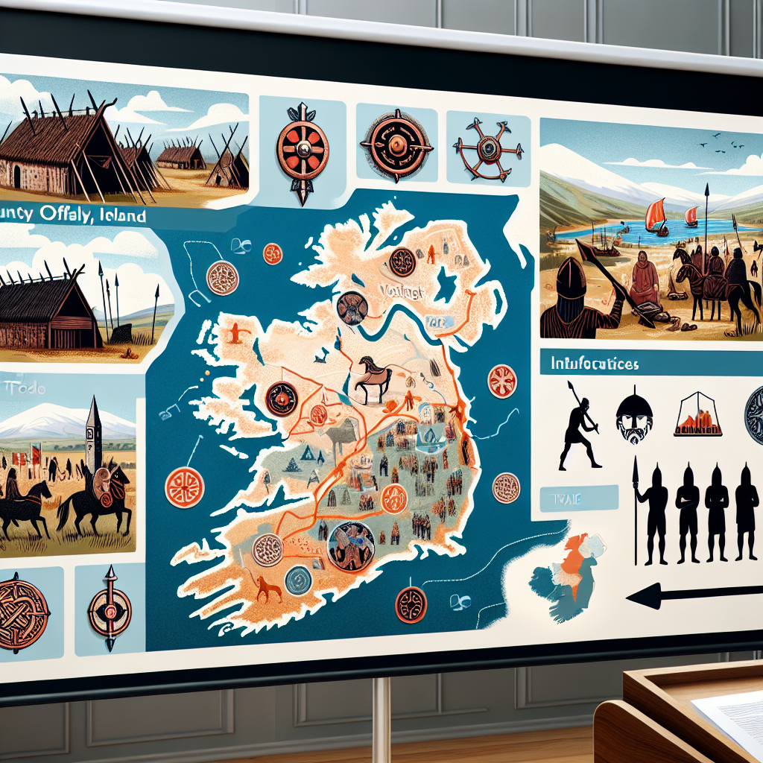
Impact of Viking Raids on Local Societies
Discussion on the dual nature of raids: destruction vs. eventual growth from conflict
How Viking presence altered local governance and alliances

Slide 8
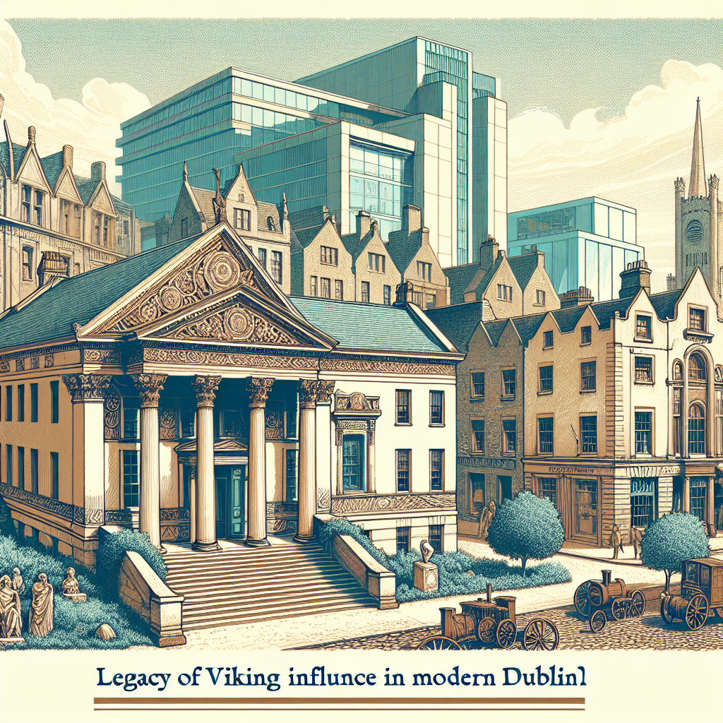
Legacy of Viking Influence in Modern Dublin
Continuation of Norse traits in modern Irish culture
Significance of archaeological findings in Dublin today

Slide 9
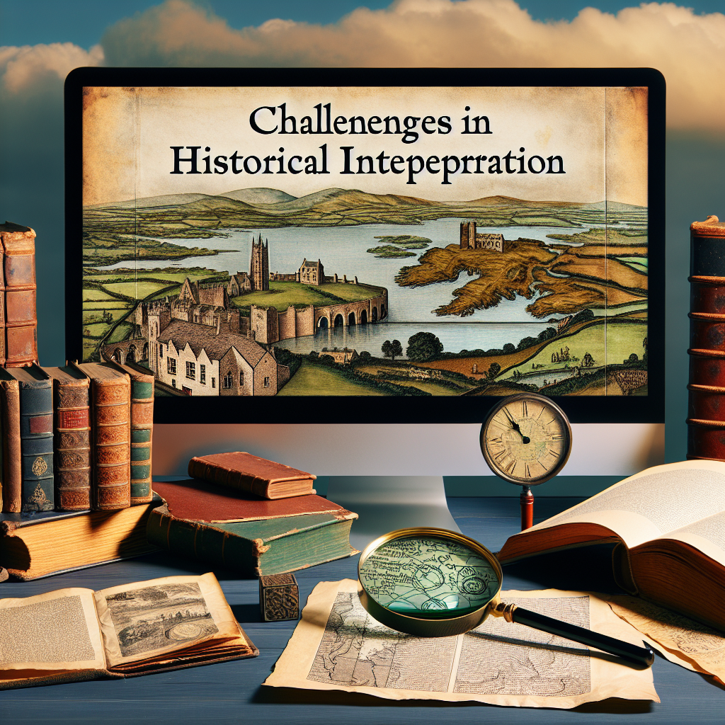
Challenges in Historical Interpretation
Debates among historians regarding the extent of Viking impact
Sources of evidence: archaeological, linguistic, and historical documents

Slide 10

Conclusion
Summary of Viking contributions to Dublin's cultural and economic landscape
Reflections on the lasting impact of Viking settlements in shaping Ireland's urban history

